Slide 1

Teaching Experience Enhancing Academic Skills Internship Presentation
My 28-Day Internship at Shivappanna Gundali Kannada Medium School, Hebbal

Slide 2
Acknowledgement
I extend my sincere thanks to Shivappanna Gundali Kannada Medium School for the invaluable internship opportunity . Grateful to the school administration, teaching staff, and students for their warm welcome and cooperation.
Special appreciation to Mrs. Seema Malaani, the Principal, for her permission and constant support. Acknowledging the dedicated teaching faculty for their guidance and expressing gratitude to the 6th and 7th standard students for their active participation and enthusiasm.

Slide 3
Executive Summary
Thanks to everyone involved in the success of the internship.
Objectives focused on enhancing students' understanding of the internet, academic mathematics, Microsoft Word, and PowerPoint.
Active engagement with students through daily teaching sessions in an interactive and participative manner.
Emphasis on creating a positive and inclusive learning environment.
Reflection on personal and professional growth.

Slide 4
Introduction
The internship took place at Shivappanna Gundali Kannada Medium School, known for its commitment to providing quality education.
Mission and vision of the school: Empowering students with knowledge, integrity, and a sense of responsibility for a future of academic excellence and societal contribution.

Slide 5
Concepts I Taught :
1. Use of the Internet:
Internet Safety and Etiquette
Effective Internet Search Techniques
2. Academic Mathematics:
Fundamental Concepts
Problem-Solving Strategies
3.Use of Microsoft Word and PowerPoint:
Microsoft Word Basics
Creating Presentations with PowerPoint

Slide 6
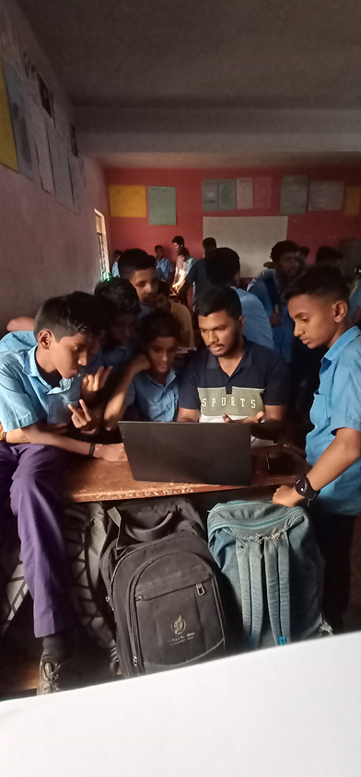
4. Practical Application Exercises:
Hands-on Activities
Collaborative Projects
5. Continuous Assessment and Feedback:
Regular Assessments
Individual Feedback Sessions
6. Interactive Learning Environment:
Engaging Discussions
Q&A Sessions
Wrap-up and Recap Sessions
Teaching how to use Chat GPT

Slide 7
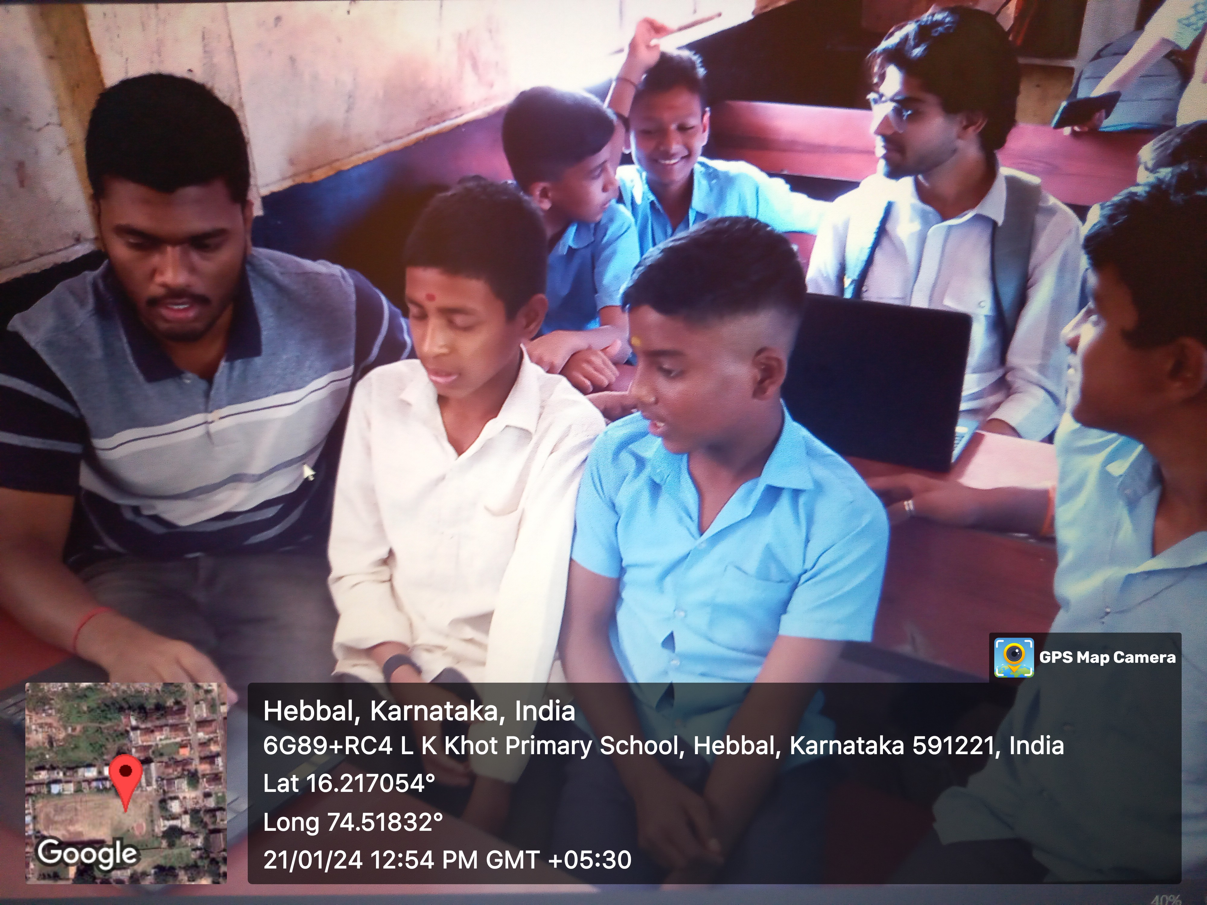
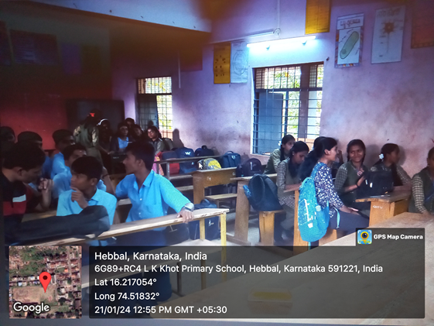
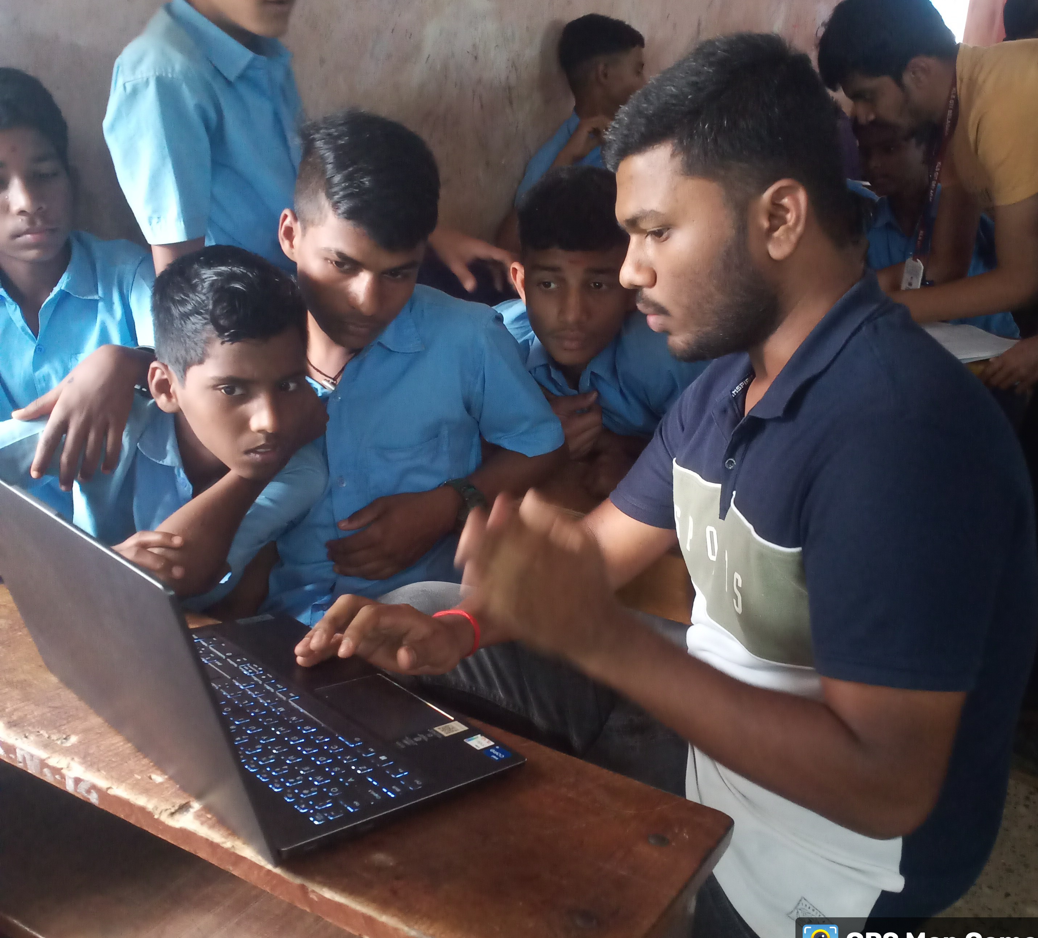
Some Moments from Internship:
Hands on with MS Word
Doubt session
Some Day

Slide 8
Challenges Faced:
Diverse Learning Needs: Encountered varying levels of academic proficiency among students, requiring personalized approaches.
Time Management: Managed the limited time available for each session, balancing content delivery with interactive activities and assessments.
Technical Glitches: Faced challenges related to technical glitches during the use of educational technology tools, requiring quick problem-solving.

Slide 9
Challenges Faced:
Maintaining Engagement: Worked to sustain student engagement throughout the sessions, especially during theoretical segments.
Individual Student Attention: Faced the challenge of providing sufficient attention to each student in a diverse classroom setting.

Slide 10
Conclusion:
In summary, my 28-day internship at Shivappanna Gundali Kannada Medium School has been transformative, enhancing my teaching methods, classroom management, and communication skills. Proficient in educational technology, I navigated challenges with resilience, and collaborative projects emphasized the value of reflective teaching.
Grateful for the school's support, this internship is a pivotal chapter in my educational journey, laying a solid foundation for future endeavors.

